Slide 1


How to construct a
Minimal Theory of Mind

Slide 2
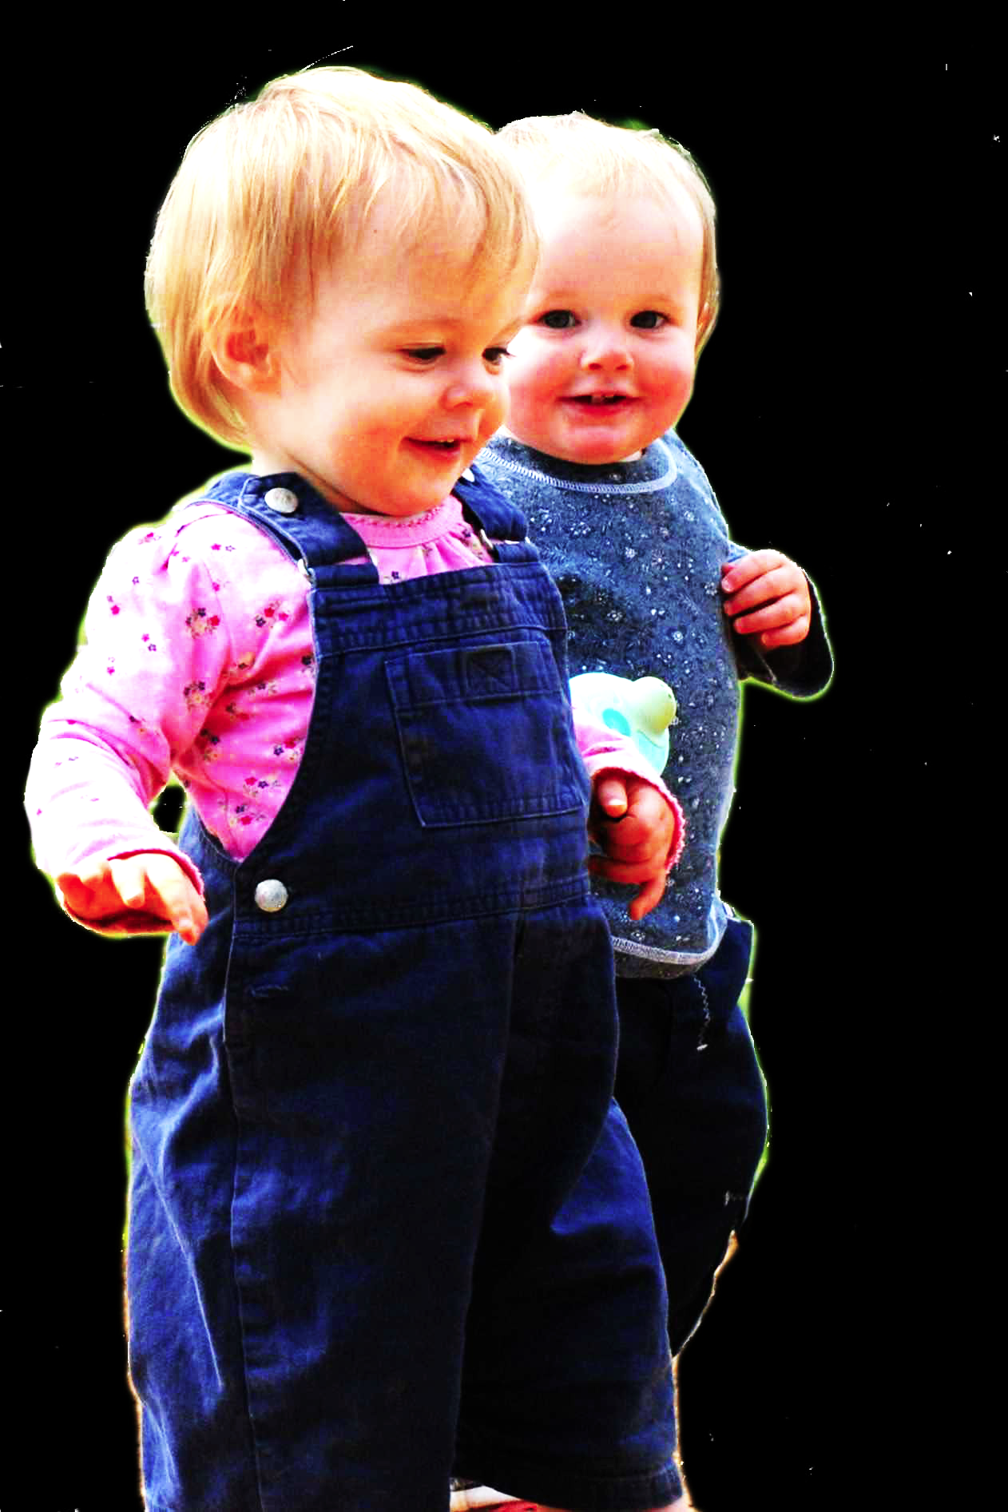
challenge
Explain the emergence, in evolution or development, of full-blown theory of mind cognition.

Slide 3
challenge
Explain the emergence, in evolution or development, of full-blown theory of mind cognition.
conjecture
We need to understand how theory of mind cognition could come in degrees.

Slide 4
challenge
Explain the emergence, in evolution or development, of full-blown theory of mind cognition.
conjecture
We need to understand how theory of mind cognition could come in degrees.
obstacle
Grasp of everyday psychological concepts like belief, desire, knowledge and intention is all-or-nothing.

Slide 5
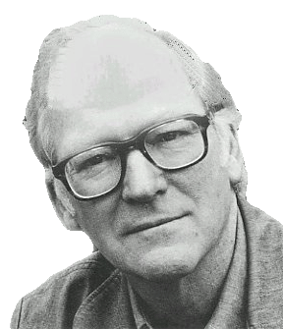
“We are stuck with our two main ways of describing and explaining things, one which treats objects and events as mindless, and the other which treats objects and events as having propositional attitudes. I see no way of bridging the gap by introducing an intermediate vocabulary.”
(Davidson 2003: 697)

Slide 6
“We are stuck with our two main ways of describing and explaining things, one which treats objects and events as mindless, and the other which treats objects and events as having propositional attitudes. I see no way of bridging the gap by introducing an intermediate vocabulary.”
(Davidson 2003: 697)

Slide 7


“chimpanzees understand … intentions … perception and knowledge … Moreover, they understand how these psychological states work together to produce intentional action”
(Call & Tomasello 2008:191)

Slide 8
“chimpanzees understand … intentions … perception and knowledge … Moreover, they understand how these psychological states work together to produce intentional action”
(Call & Tomasello 2008:191)
“chimpanzees probably do not understand others in terms of a fully human-like belief–desire psychology”
(Call and Tomasello 2008)

Slide 9
“chimpanzees understand … intentions … perception and knowledge … Moreover, they understand how these psychological states work together to produce intentional action”
(Call & Tomasello 2008:191)
“chimpanzees probably do not understand others in terms of a fully human-like belief–desire psychology”
(Call and Tomasello 2008)

Slide 10

“chimpanzees understand … intentions … perception and knowledge … Moreover, they understand how these psychological states work together to produce intentional action”
(Call & Tomasello 2008:191)
“our [typical adult humans’] fundamental conception of what it is to know that P is itself an explanatory conception […] we think of S’s knowledge that P as something that can properly be explained by reference to what S has perceived or remembered or proved or ...”
(Cassam 2007: 356)

Slide 11
challenge
Explain the emergence, in evolution or development, of full-blown theory of mind cognition.
conjecture
We need to understand how theory of mind cognition could come in degrees.
obstacle
Grasp of everyday psychological concepts like belief, desire, knowledge and intention is all-or-nothing.

Slide 12
puzzle

Slide 13

Theory of mind abilities are widespread

Slide 14
Theory of mind abilities are widespread
18-month-olds point to inform, and predict actions based on false beliefs
(Liszkowski et al 2006)
(Onishi & Baillargeon 2005; Southgate et al 2007)

Slide 15
Theory of mind abilities are widespread
18-month-olds point to inform, and predict actions based on false beliefs
Scrub-jays selectively re-cache their food in ways that deprive competitors of knowledge of its location
(Liszkowski et al 2006)
(Onishi & Baillargeon 2005; Southgate et al 2007)
(Clayton, Dally & Emery 2007)

Slide 16
Theory of mind abilities are widespread
18-month-olds point to inform, and predict actions based on false beliefs
Scrub-jays selectively re-cache their food in ways that deprive competitors of knowledge of its location
Chimpanzees conceal their approach from a competitor’s view, and act in ways that are optimal given what another has seen
(Liszkowski et al 2006)
(Onishi & Baillargeon 2005; Southgate et al 2007)
(Clayton, Dally & Emery 2007)
(Hare, Call & Tomasello 2006)
(Hare, Call & Tomasello 2001)

Slide 17
Theory of mind abilities are widespread
18-month-olds point to inform, and predict actions based on false beliefs
Scrub-jays selectively re-cache their food in ways that deprive competitors of knowledge of its location
Chimpanzees conceal their approach from a competitor’s view, and act in ways that are optimal given what another has seen
(Liszkowski et al 2006)
(Onishi & Baillargeon 2005; Southgate et al 2007)
(Clayton, Dally & Emery 2007)
(Hare, Call & Tomasello 2006)
(Hare, Call & Tomasello 2001)

Slide 18
Theory of mind abilities are widespread
18-month-olds point to inform, and predict actions based on false beliefs
Scrub-jays selectively re-cache their food in ways that deprive competitors of knowledge of its location
Chimpanzees conceal their approach from a competitor’s view, and act in ways that are optimal given what another has seen
(Liszkowski et al 2006)
(Onishi & Baillargeon 2005; Southgate et al 2007)
(Clayton, Dally & Emery 2007)
(Hare, Call & Tomasello 2006)
(Hare, Call & Tomasello 2001)

Slide 19
Theory of mind abilities are widespread
18-month-olds point to inform, and predict actions based on false beliefs
Scrub-jays selectively re-cache their food in ways that deprive competitors of knowledge of its location
Chimpanzees conceal their approach from a competitor’s view, and act in ways that are optimal given what another has seen
Representing perceptions, knowledge states and beliefs is hard

Slide 20
Theory of mind abilities are widespread
18-month-olds point to inform, and predict actions based on false beliefs
Scrub-jays selectively re-cache their food in ways that deprive competitors of knowledge of its location
Chimpanzees conceal their approach from a competitor’s view, and act in ways that are optimal given what another has seen
Representing perceptions, knowledge states and beliefs is hard, for it requires
(a) conceptual sophistication
- takes years to develop
- development tied to acquisition of executive function and language
- development facilitated by training and siblings

Slide 21
Theory of mind abilities are widespread
18-month-olds point to inform, and predict actions based on false beliefs
Scrub-jays selectively re-cache their food in ways that deprive competitors of knowledge of its location
Chimpanzees conceal their approach from a competitor’s view, and act in ways that are optimal given what another has seen
Representing perceptions, knowledge states and beliefs is hard, for it requires
(a) conceptual sophistication
- takes years to develop
- development tied to acquisition of executive function and language
- development facilitated by training and siblings
(b) scarce cognitive resources
- attention
- working memory

Slide 22
Theory of mind abilities are widespread
18-month-olds point to inform, and predict actions based on false beliefs
Scrub-jays selectively re-cache their food in ways that deprive competitors of knowledge of its location
Chimpanzees conceal their approach from a competitor’s view, and act in ways that are optimal given what another has seen
Representing perceptions, knowledge states and beliefs is hard, for it requires
(a) conceptual sophistication
- takes years to develop
- development tied to acquisition of executive function and language
- development facilitated by training and siblings
(b) scarce cognitive resources
- attention
- working memory

Slide 23
Propositional attitudes …
cause actions
resemble “intervening variables” linking environment to behaviour
have contents which may be true or false
have contents which may refer to non-existent entities
are involved in uncodifiably complex causal interactions
have contents which are individuated by senses, not only by referents
are associated with normative requirements
are indviduated in terms of their interlocking roles in causal and normative explanations of thought and action
…

Slide 24
puzzle
What could infants, chimps and scrub-jays represent that would enable them, within limits, to track others’ perceptions, knowledge, beliefs and other propositional attitudes?

Slide 25



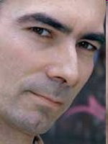
puzzle
What could infants, chimps and scrub-jays represent that would enable them, within limits, to track others’ perceptions, knowledge, beliefs and other propositional attitudes?

Slide 26
challenge
Explain the emergence, in evolution or development, of full-blown theory of mind cognition.
puzzle
What could infants, chimps and scrub-jays represent that would enable them, within limits, to track others’ perceptions, knowledge, beliefs and other propositional attitudes?

Slide 27

challenge
Explain the emergence, in evolution or development, of full-blown theory of mind cognition.
puzzle
What could infants, chimps and scrub-jays represent that would enable them, within limits, to track others’ perceptions, knowledge, beliefs and other propositional attitudes?

Slide 28


